Slide 1
WordPress Theming Going Beyond the Dashboard
Brian Retterer
@bretterer
KCDC 2018 7/13/2018

Slide 2

Who is Brian?
PHP Developer for 14+ years
WordPress User / Developer Since 2004
Head Organizer of Dayton WordPress Meetup
Organizer of Dayton WordCamp
Contributor to WordPress
WordPress Community Supporter
Developer Advocate @ Okta
WordPress Theming: Going Beyond the Dashboard
Brian Retterer | @bretterer

Slide 3
Topics
About WordPress
What is a Theme
What is a Child Theme
Developing a Child Theme

Slide 4
WordPress Theming: Going Beyond the Dashboard
About WordPress
What is a Theme
What is a Child Theme
Developing a Child Theme

Slide 5



Matt Mullenweg
Mike Little
https://poststatus.com/matt-mullenweg-state-word-2017/
https://mikelittle.org/wp-content/uploads/2011/07/mike-2012-1000-300x300.jpg
WordPress Theming: Going Beyond the Dashboard
Brian Retterer | @bretterer

Slide 6

EST. 2003
WordPress Theming: Going Beyond the Dashboard
Brian Retterer | @bretterer
Notes:
Fork of b2/cafelog
B2/cafelog was developed in early 2001 by Michel Valdrighi
B2/cafelog version 0.6 was released in 2001. After that, Michel Valdrighi continued his development work. Throughout 2002, he worked on created b2/cafelog version 1.0. And then, suddenly, in December of that year, he vanished.
Matt Mullenweg, a b2/cafelog user, was one of those troubled by the lack of support.
So in January 2003, Mullenweg came up with the idea to create a new platform by integrating the "cool stuff" in b2/cafelog and adding more features.
Became the official branch of b2/cafelog due to personal issue with its creator

Slide 7











WordPress Theming: Going Beyond the Dashboard
Brian Retterer | @bretterer

Slide 8






WHO USES WORDPRESS?
31%
WordPress Theming: Going Beyond the Dashboard
Brian Retterer | @bretterer

Slide 9

VS
WordPress Theming: Going Beyond the Dashboard
Brian Retterer | @bretterer

Slide 10
WordPress Theming: Going Beyond the Dashboard
About WordPress
What is a Theme
What is a Child Theme
Developing a Child Theme

Slide 11
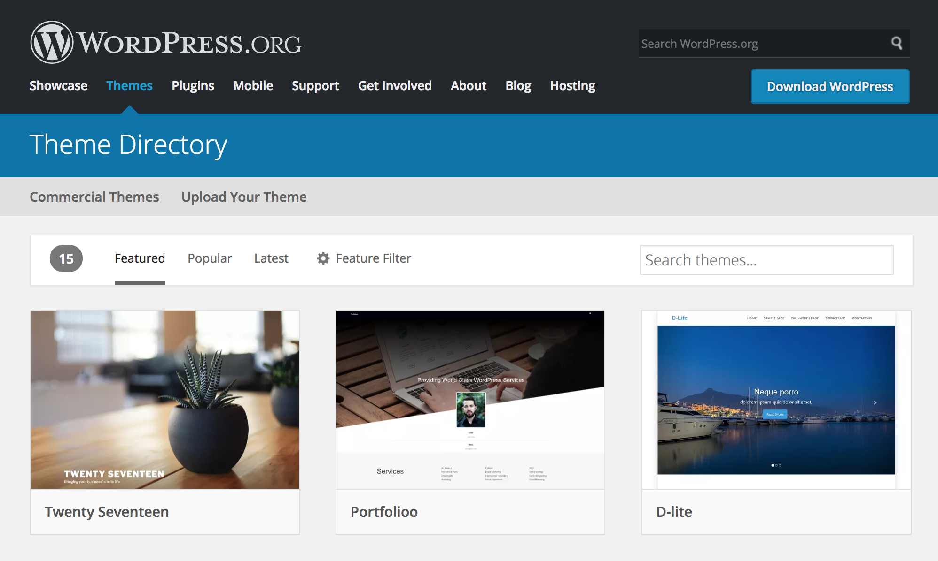
WordPress Theming: Going Beyond the Dashboard
Brian Retterer | @bretterer
Notes:
16,960 as of 7/13

Slide 12
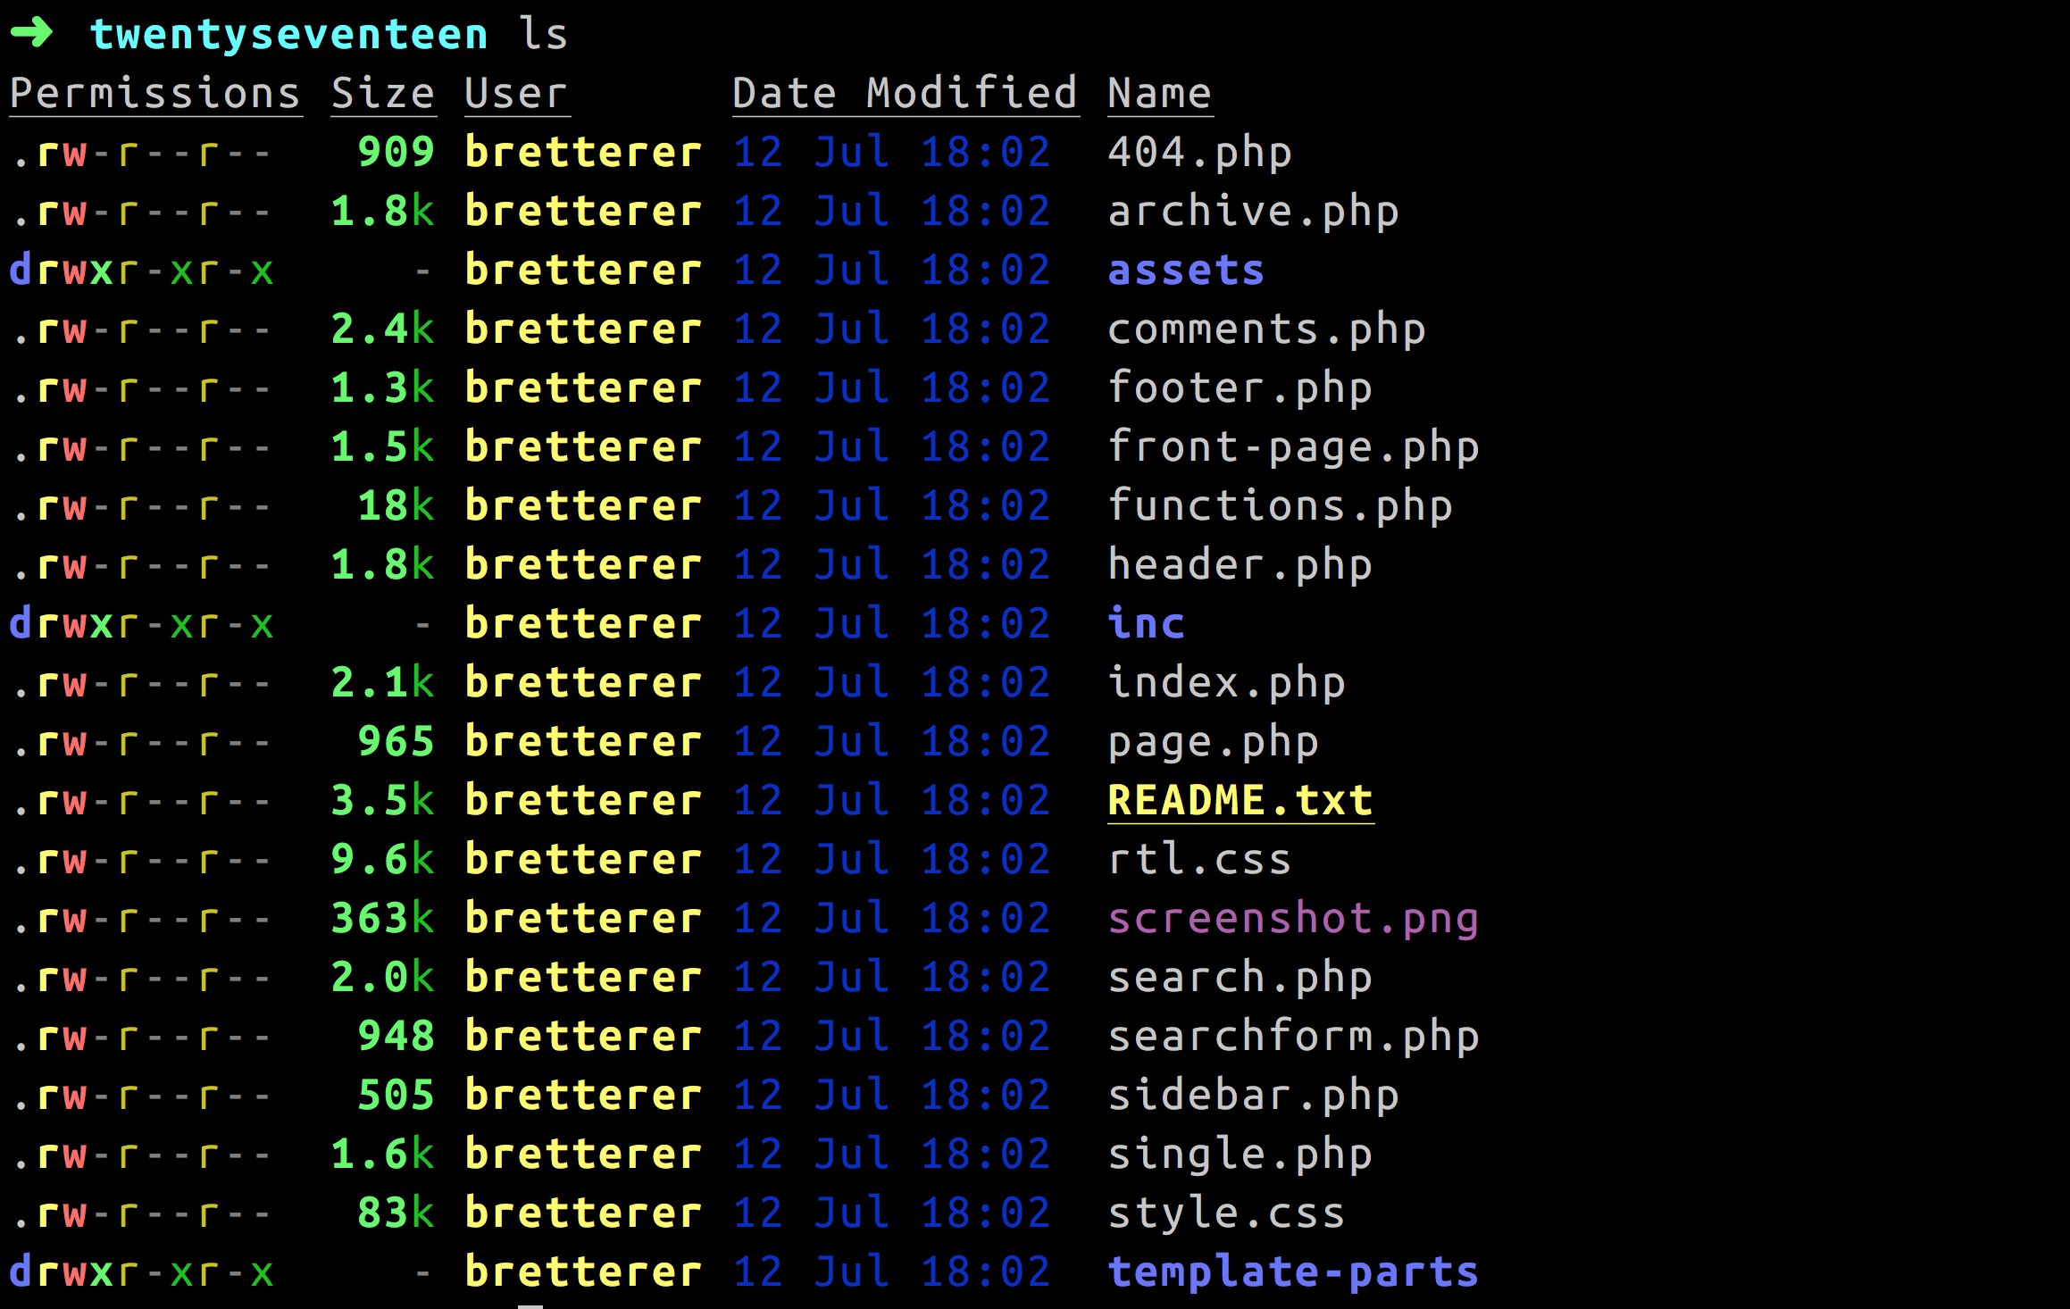
WordPress Theming: Going Beyond the Dashboard
Brian Retterer | @bretterer

Slide 13
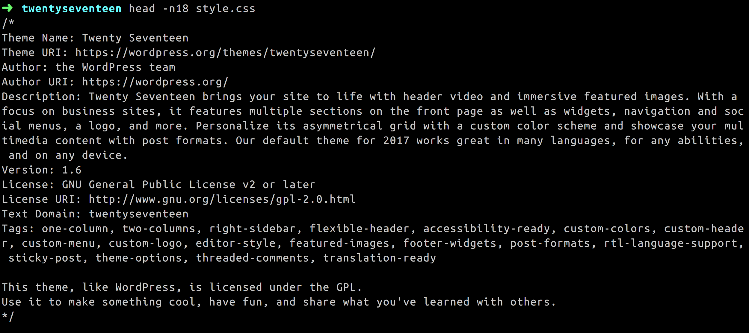
WordPress Theming: Going Beyond the Dashboard
Brian Retterer | @bretterer

Slide 14
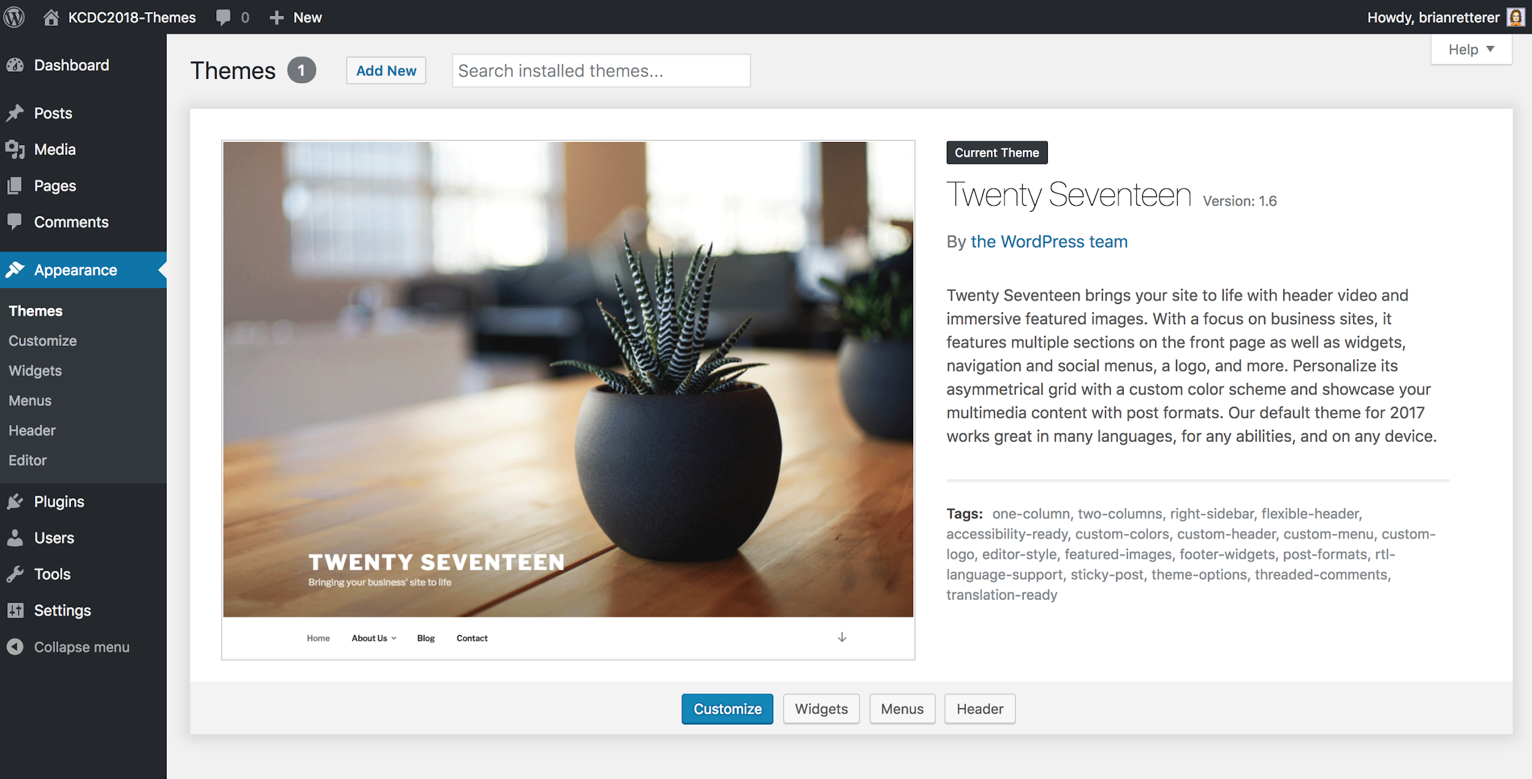
WordPress Theming: Going Beyond the Dashboard
Brian Retterer | @bretterer

Slide 15
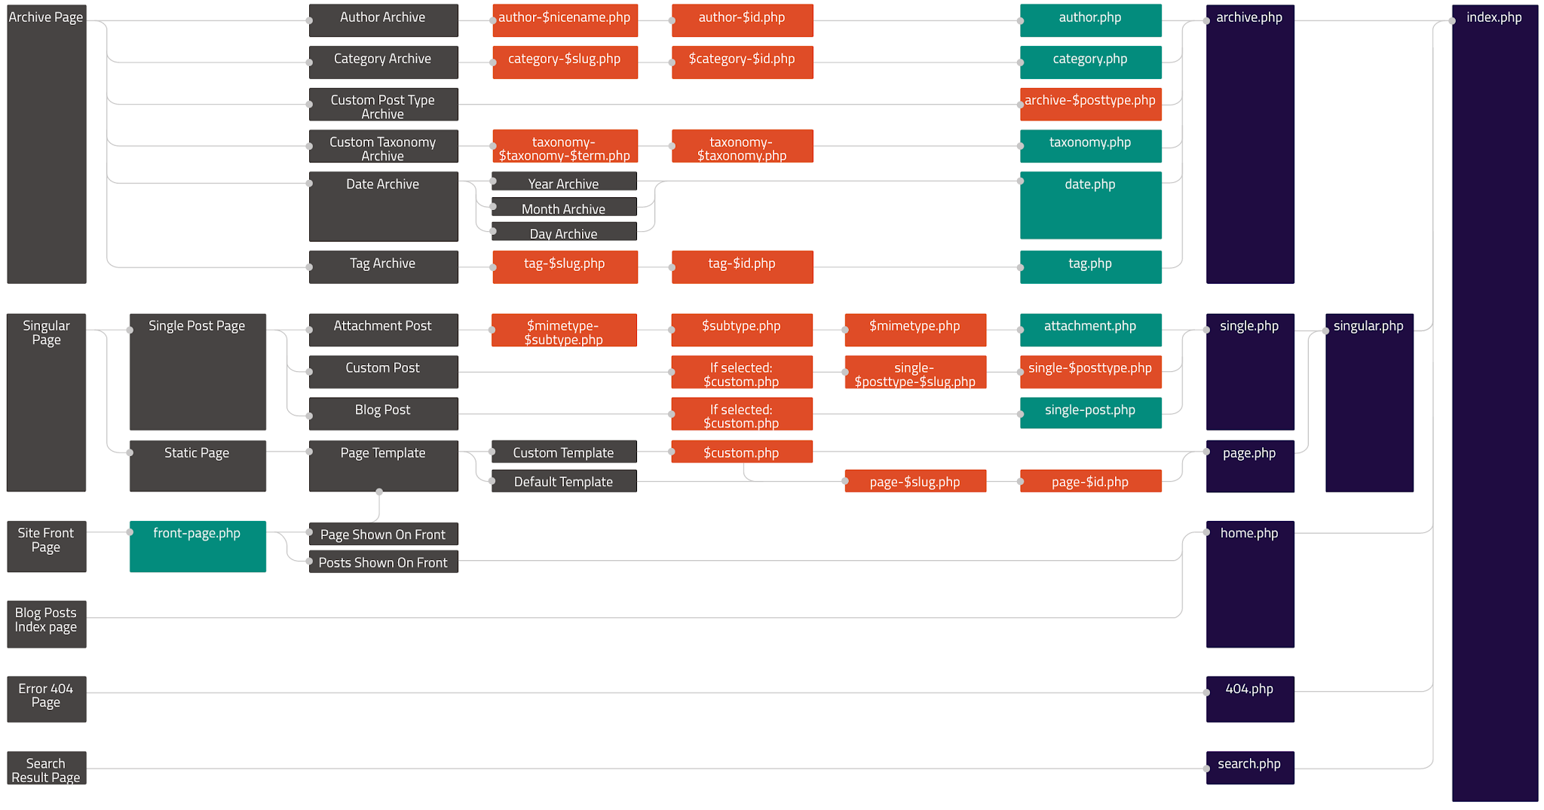
WordPress Theming: Going Beyond the Dashboard
Brian Retterer | @bretterer

Slide 16
WordPress Theming: Going Beyond the Dashboard
Brian Retterer | @bretterer
Notes:
If your blog is at http://example.com/ and a visitor clicks on a link to a category page such as http://example.com/category/bacon/, WordPress looks for a template file in the current theme’s directory that matches the category’s ID to generate the correct page.

Slide 17
WordPress Theming: Going Beyond the Dashboard
Brian Retterer | @bretterer

Slide 18
WordPress Theming: Going Beyond the Dashboard
Brian Retterer | @bretterer
Notes:
Looks for a template file in the current theme’s directory that matches the category’s slug. If the category slug is “bacon,” then WordPress looks for a template file named category-bacon.php.

Slide 19
WordPress Theming: Going Beyond the Dashboard
Brian Retterer | @bretterer
Notes:
If category-bacon.php is missing and the category’s ID is 4, WordPress looks for a template file named category-4.php.

Slide 20
WordPress Theming: Going Beyond the Dashboard
Brian Retterer | @bretterer
Notes:
If category-4.php is missing, WordPress will look for a generic category template file, category.php.

Slide 21
WordPress Theming: Going Beyond the Dashboard
Brian Retterer | @bretterer
Notes:
If category.php does not exist, WordPress will look for a generic archive template, archive.php.

Slide 22
WordPress Theming: Going Beyond the Dashboard
Brian Retterer | @bretterer
Notes:
If archive.php is also missing, WordPress will fall back to the main theme template file, index.php.

Slide 23
WordPress Theming: Going Beyond the Dashboard
Brian Retterer | @bretterer

Slide 24
WordPress Theming: Going Beyond the Dashboard
Brian Retterer | @bretterer

Slide 25
WordPress Theming: Going Beyond the Dashboard
Brian Retterer | @bretterer

Slide 26
WordPress Theming: Going Beyond the Dashboard
Brian Retterer | @bretterer

Slide 27
WordPress Theming: Going Beyond the Dashboard
Brian Retterer | @bretterer

Slide 28
WordPress Theming: Going Beyond the Dashboard
About WordPress
What is a Theme
What is a Child Theme
Developing a Child Theme

Slide 29
When Should I Use A Child Theme?
WordPress Theming: Going Beyond the Dashboard
Brian Retterer | @bretterer

Slide 30
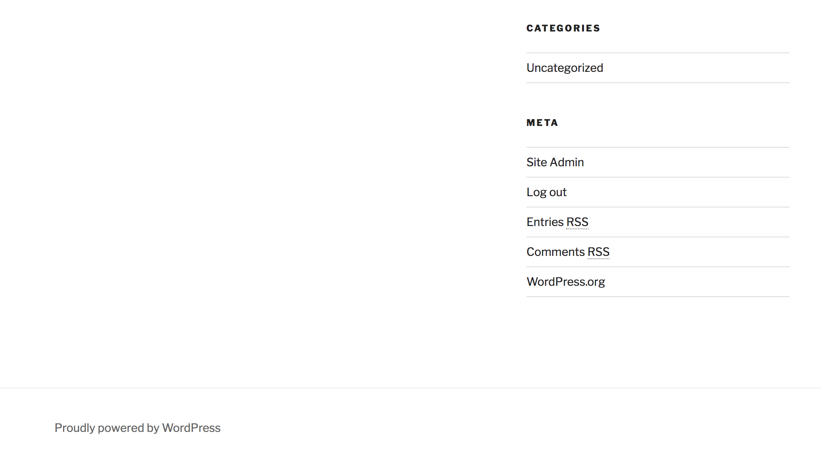
WordPress Theming: Going Beyond the Dashboard
Brian Retterer | @bretterer
Notes:
Change “Proudly powered by WordPress”

Slide 31
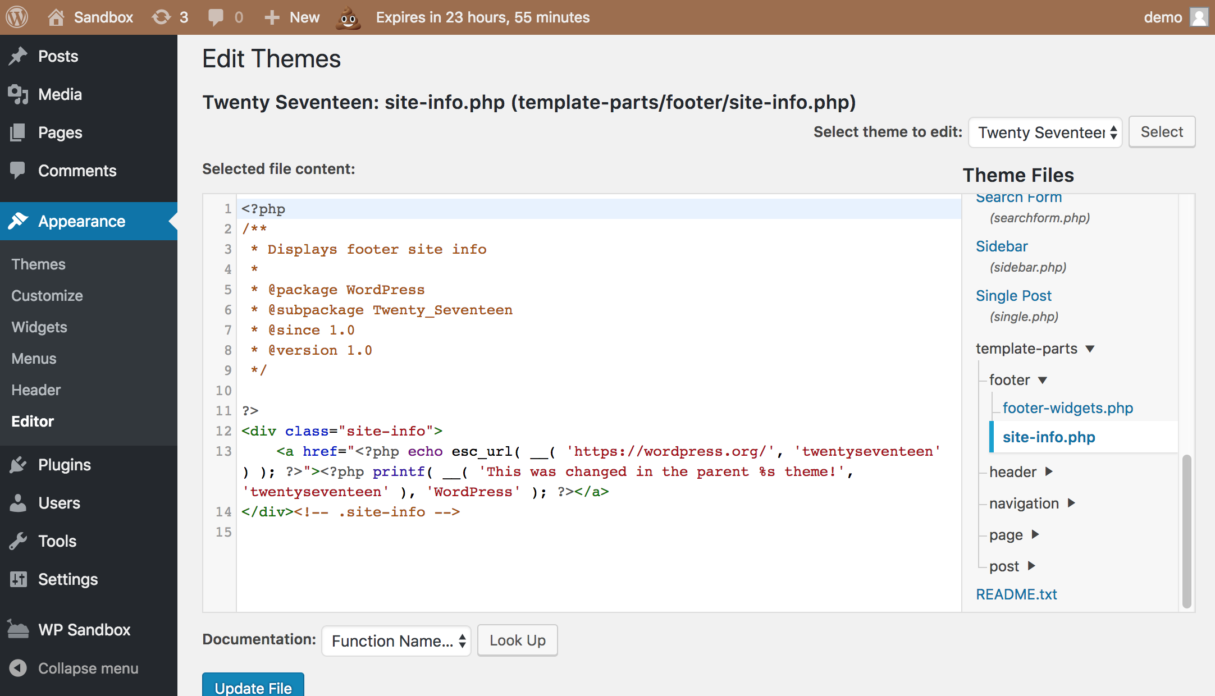
WordPress Theming: Going Beyond the Dashboard
Brian Retterer | @bretterer

Slide 32
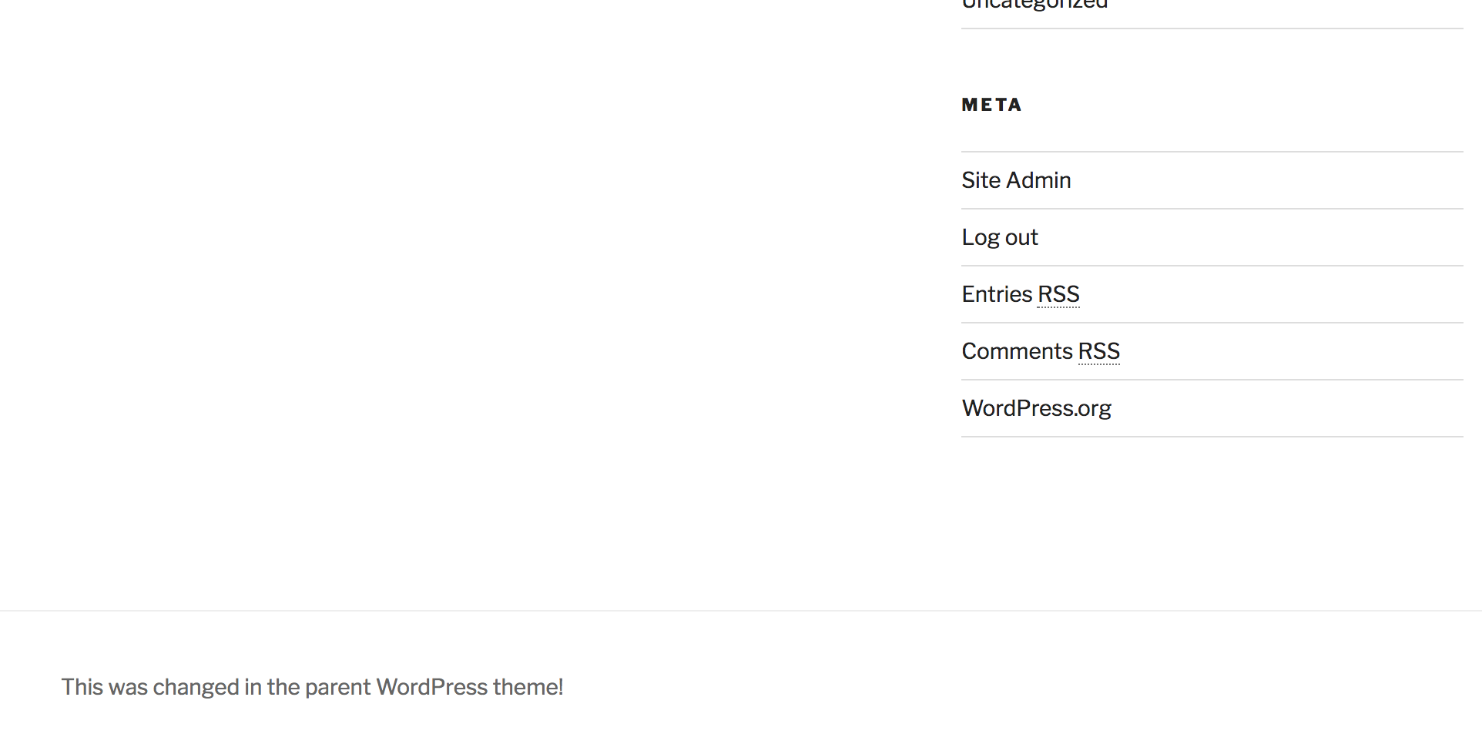
WordPress Theming: Going Beyond the Dashboard
Brian Retterer | @bretterer

Slide 33
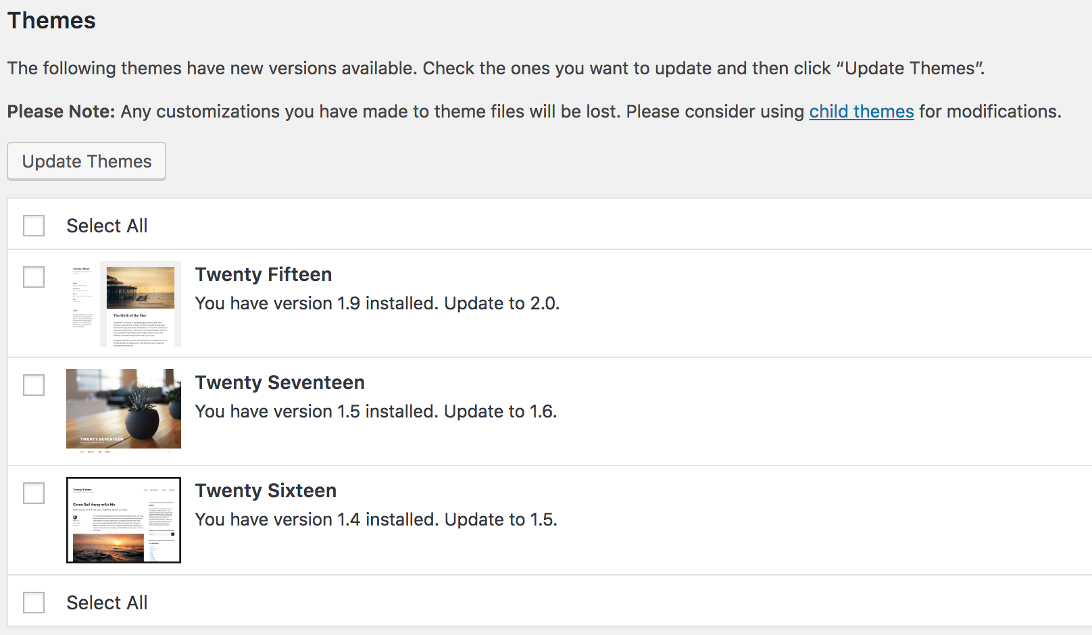
WordPress Theming: Going Beyond the Dashboard
Brian Retterer | @bretterer

Slide 34
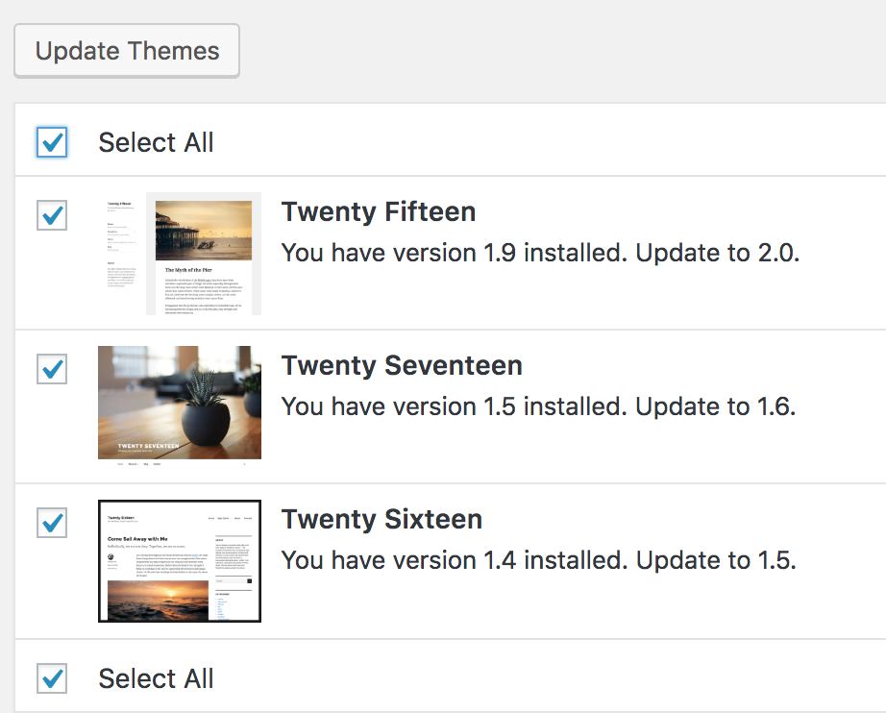
WordPress Theming: Going Beyond the Dashboard
Brian Retterer | @bretterer

Slide 35
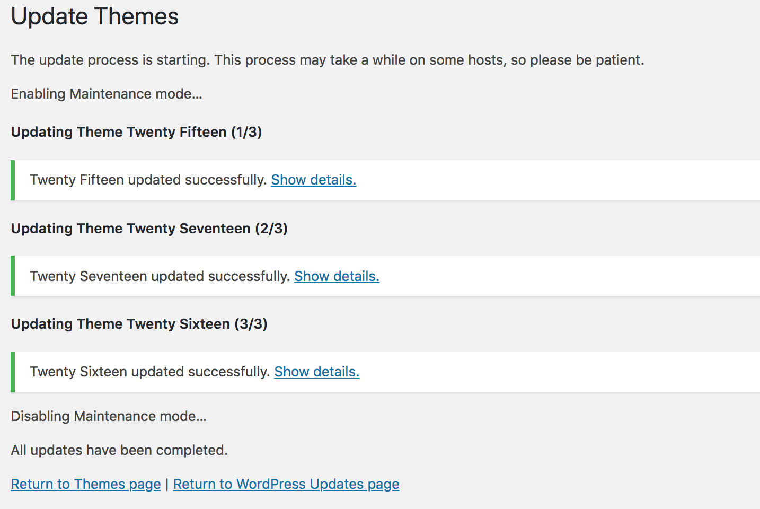
WordPress Theming: Going Beyond the Dashboard
Brian Retterer | @bretterer

Slide 36
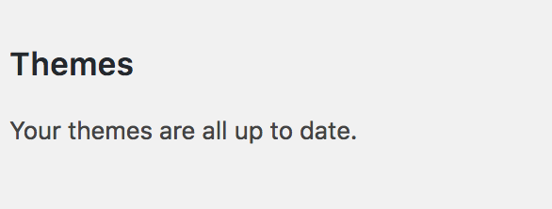
WordPress Theming: Going Beyond the Dashboard
Brian Retterer | @bretterer

Slide 37
WordPress Theming: Going Beyond the Dashboard
Brian Retterer | @bretterer

Slide 38
When Should I Avoid A Child Theme?
WordPress Theming: Going Beyond the Dashboard
Brian Retterer | @bretterer

Slide 39
NEVER!
When Should I Avoid A Child Theme?
WordPress Theming: Going Beyond the Dashboard
Brian Retterer | @bretterer

Slide 40
WordPress Theming: Going Beyond the Dashboard
About WordPress
What is a Theme
What is a Child Theme
Developing a Child Theme

Slide 41
Starter Boilerplate
vs
Custom
WordPress Theming: Going Beyond the Dashboard
Brian Retterer | @bretterer

Slide 42



Starter Boilerplate
WordPress Theming: Going Beyond the Dashboard
Brian Retterer | @bretterer

Slide 43
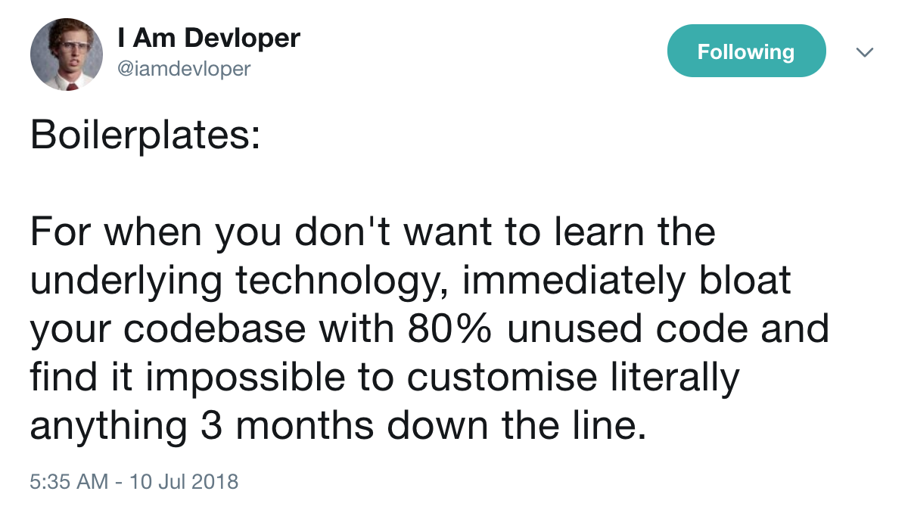
Custom
WordPress Theming: Going Beyond the Dashboard
Brian Retterer | @bretterer

Slide 44
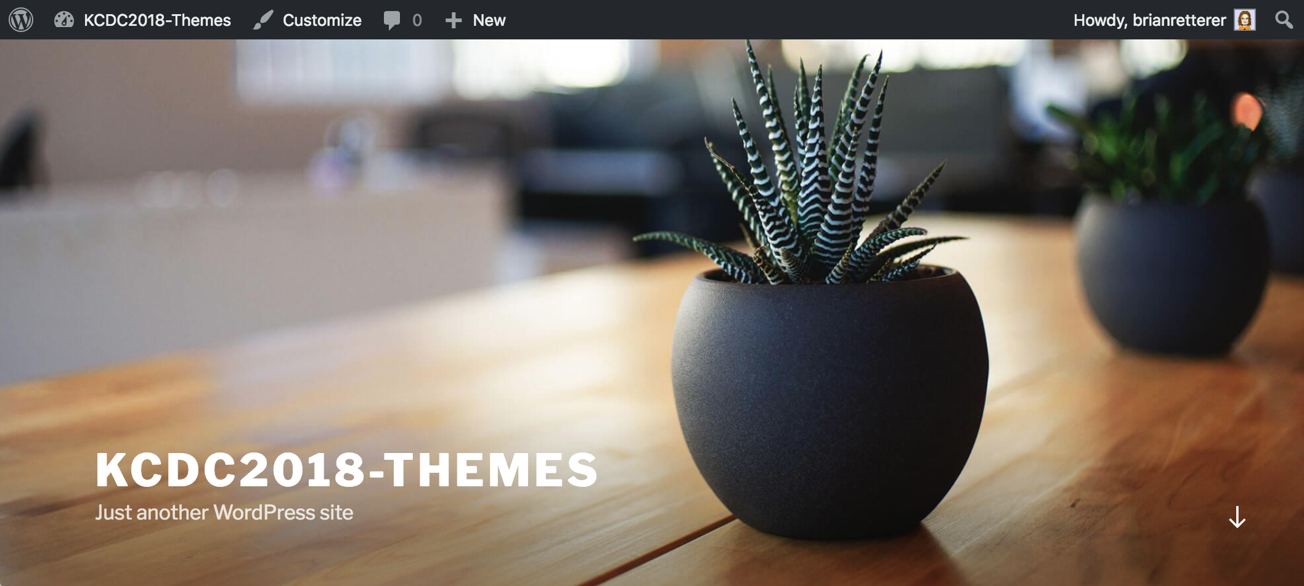
WordPress Theming: Going Beyond the Dashboard
Brian Retterer | @bretterer
Notes:
What we have.

Slide 45
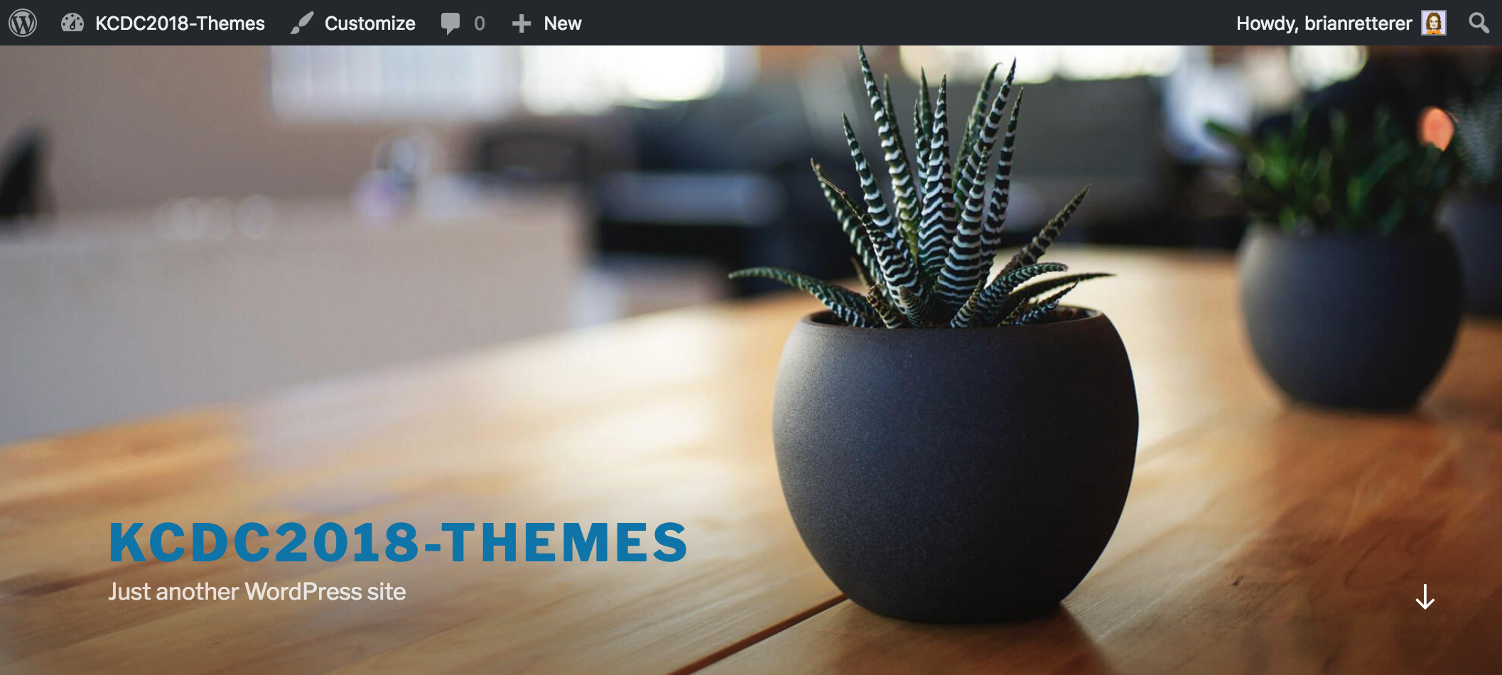
WordPress Theming: Going Beyond the Dashboard
Brian Retterer | @bretterer
Notes:
What we want.
Change the color of the title.

Slide 46
DISCLAIMER
WordPress Theming: Going Beyond the Dashboard
Brian Retterer | @bretterer
Notes:
DISCLAIMER:
Yes, Customizer Additional CSS works fine for this change, but lets create a child theme instead.

Slide 47
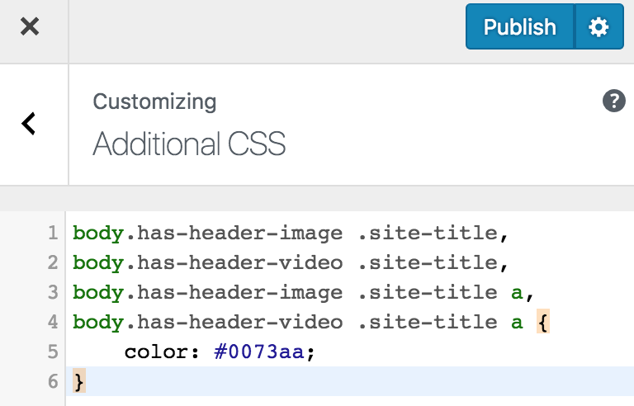
WordPress Theming: Going Beyond the Dashboard
Brian Retterer | @bretterer
Notes:
DISCLAIMER:
Yes, Customizer Additional CSS works fine for this change, but lets create a child theme instead.

Slide 48
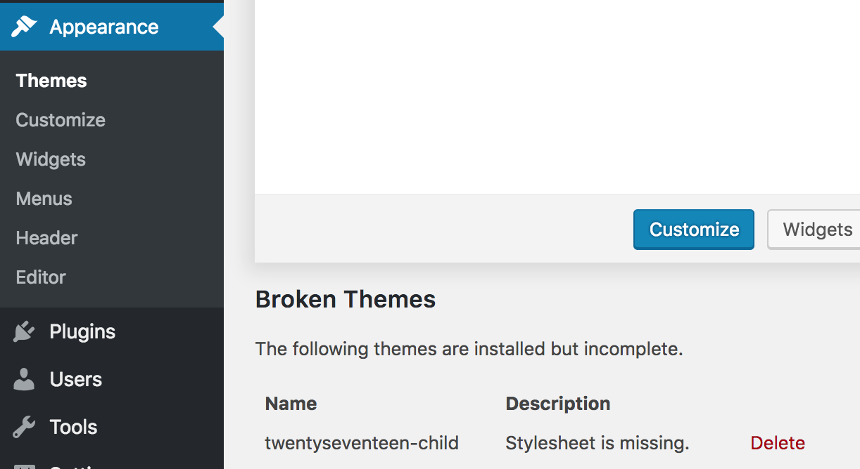
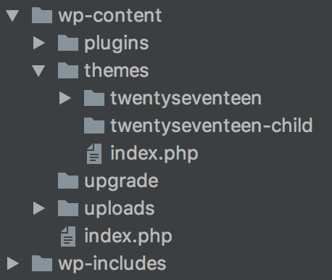
WordPress Theming: Going Beyond the Dashboard
Brian Retterer | @bretterer

Slide 49
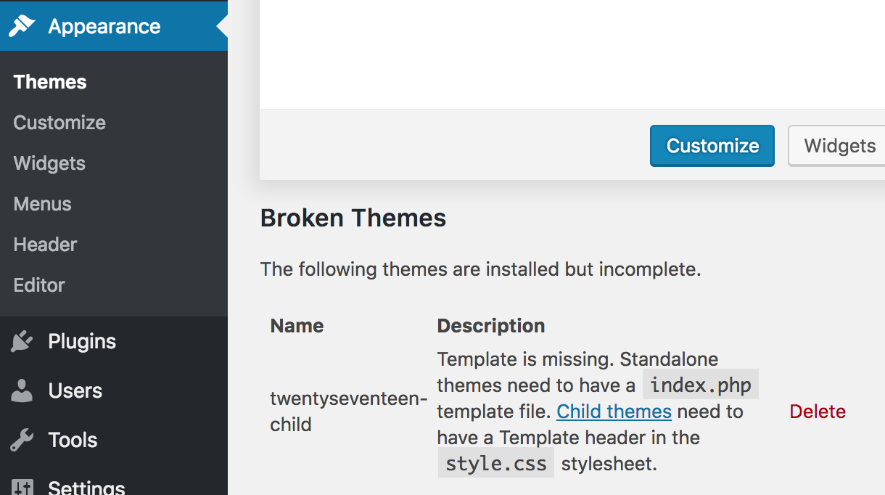
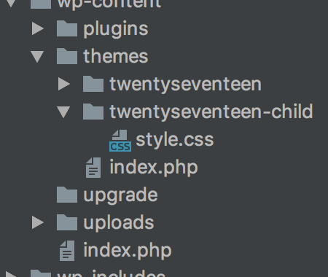
WordPress Theming: Going Beyond the Dashboard
Brian Retterer | @bretterer

Slide 50
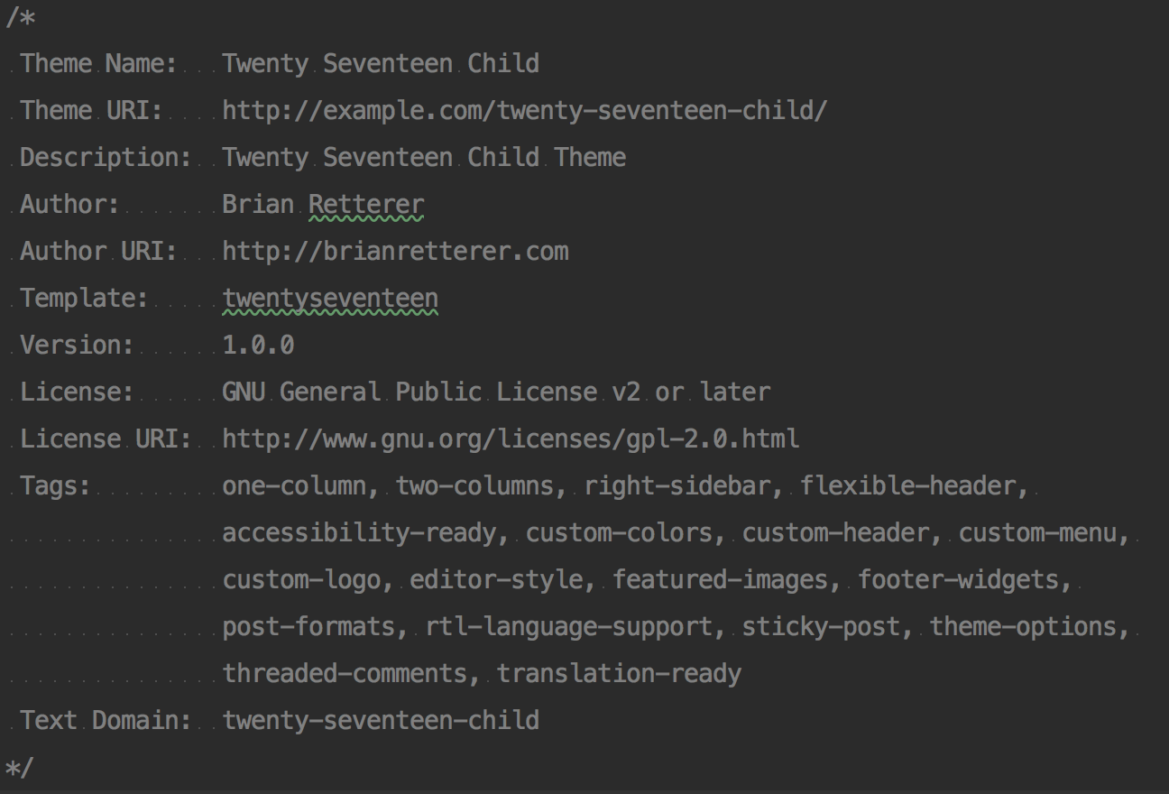
WordPress Theming: Going Beyond the Dashboard
Brian Retterer | @bretterer

Slide 51
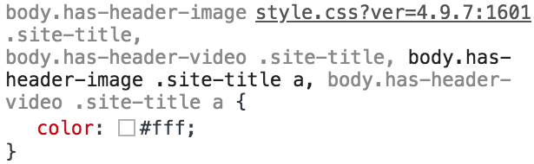
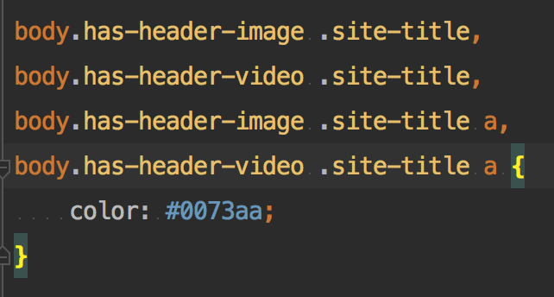
WordPress Theming: Going Beyond the Dashboard
Brian Retterer | @bretterer

Slide 52
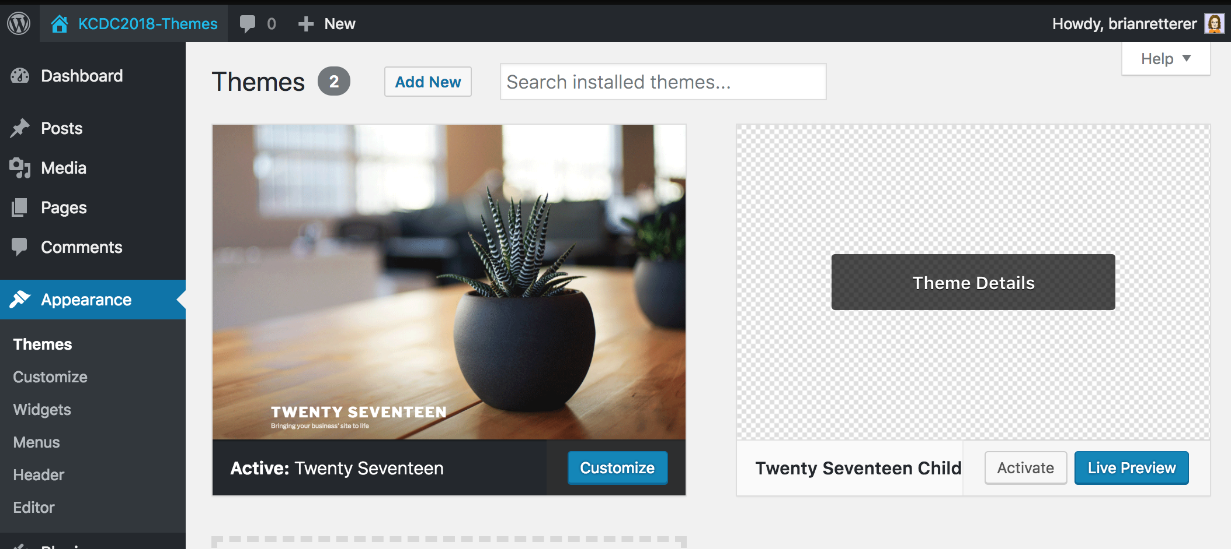
WordPress Theming: Going Beyond the Dashboard
Brian Retterer | @bretterer

Slide 53
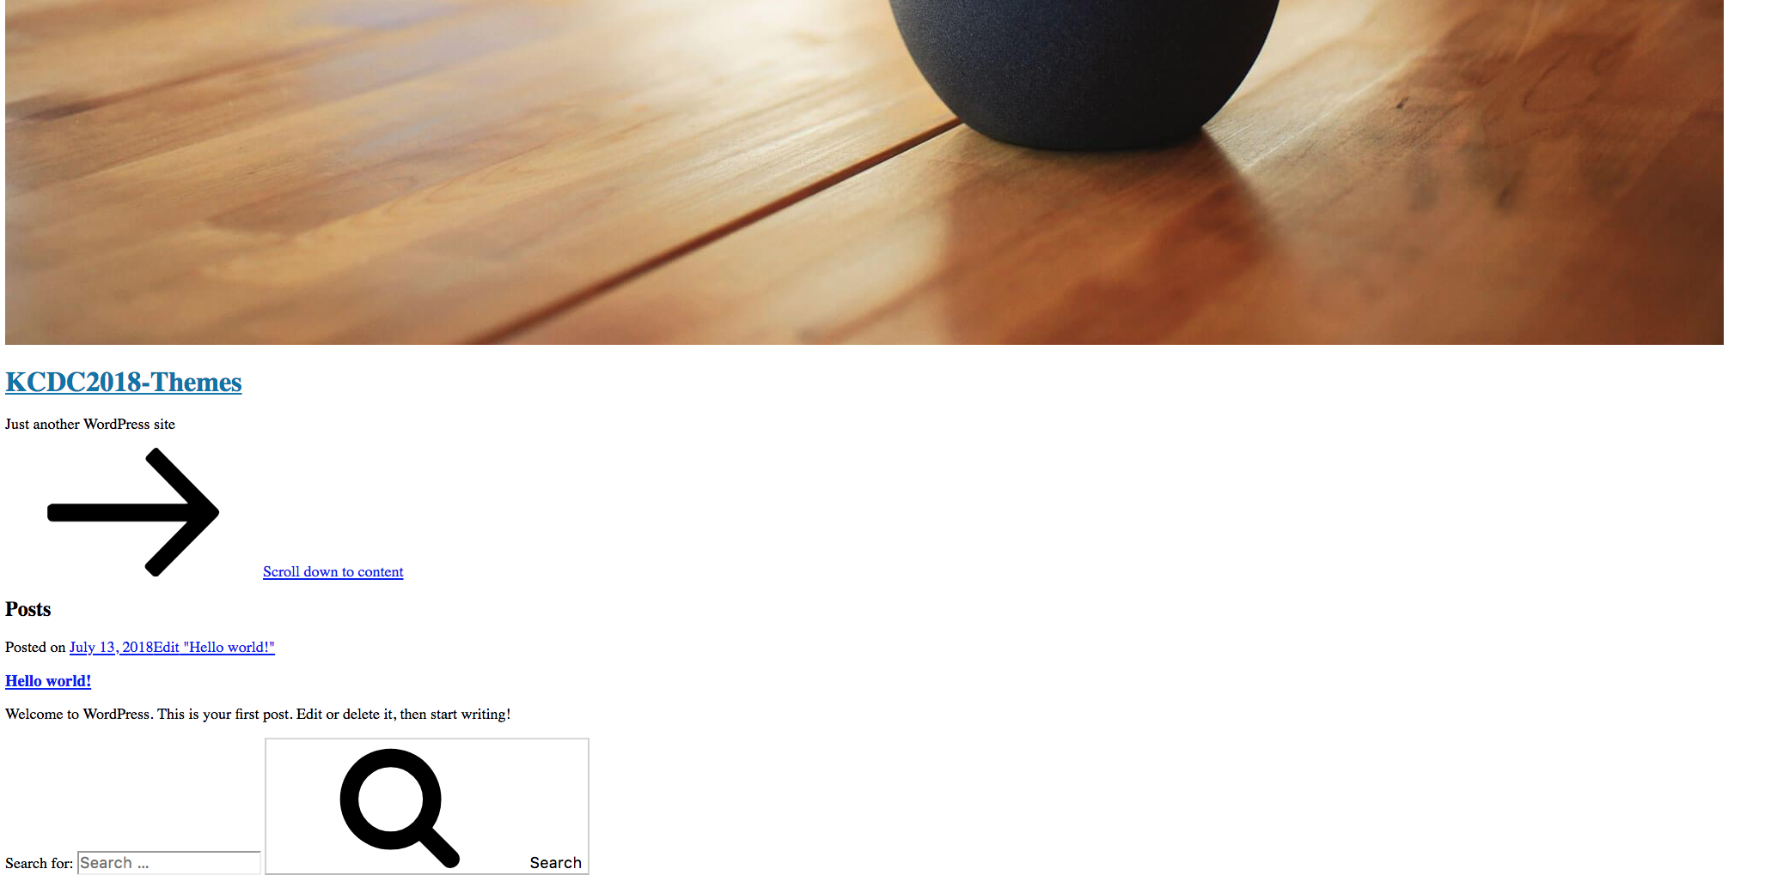
What Happened?
WordPress Theming: Going Beyond the Dashboard
Brian Retterer | @bretterer

Slide 54
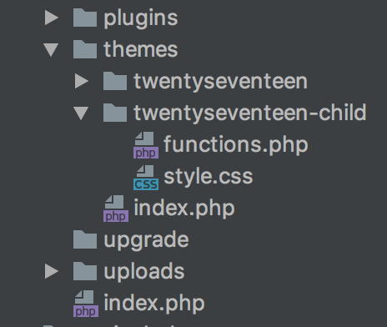
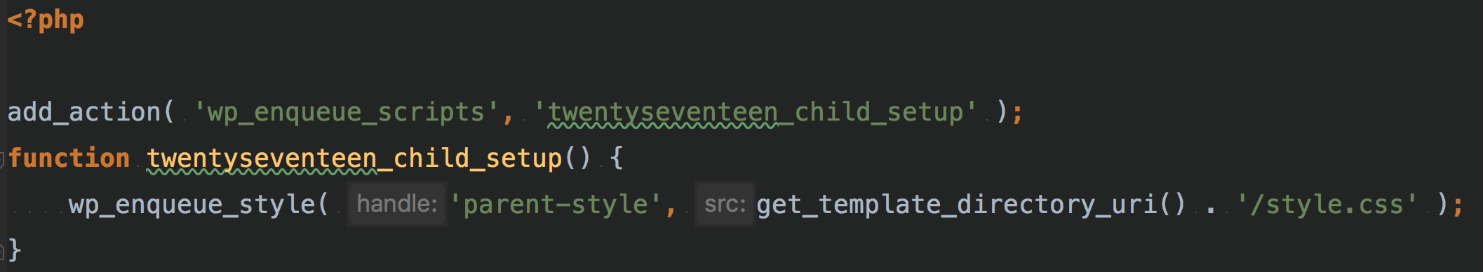
wp_enqueue_style()
WordPress Theming: Going Beyond the Dashboard
Brian Retterer | @bretterer
Notes:
Note that the previous method was to import the parent theme stylesheet using @import: this is no longer best practice, as it increases the amount of time it takes style sheets to load.

Slide 55
NOT BLUE!
WordPress Theming: Going Beyond the Dashboard
Brian Retterer | @bretterer

Slide 56
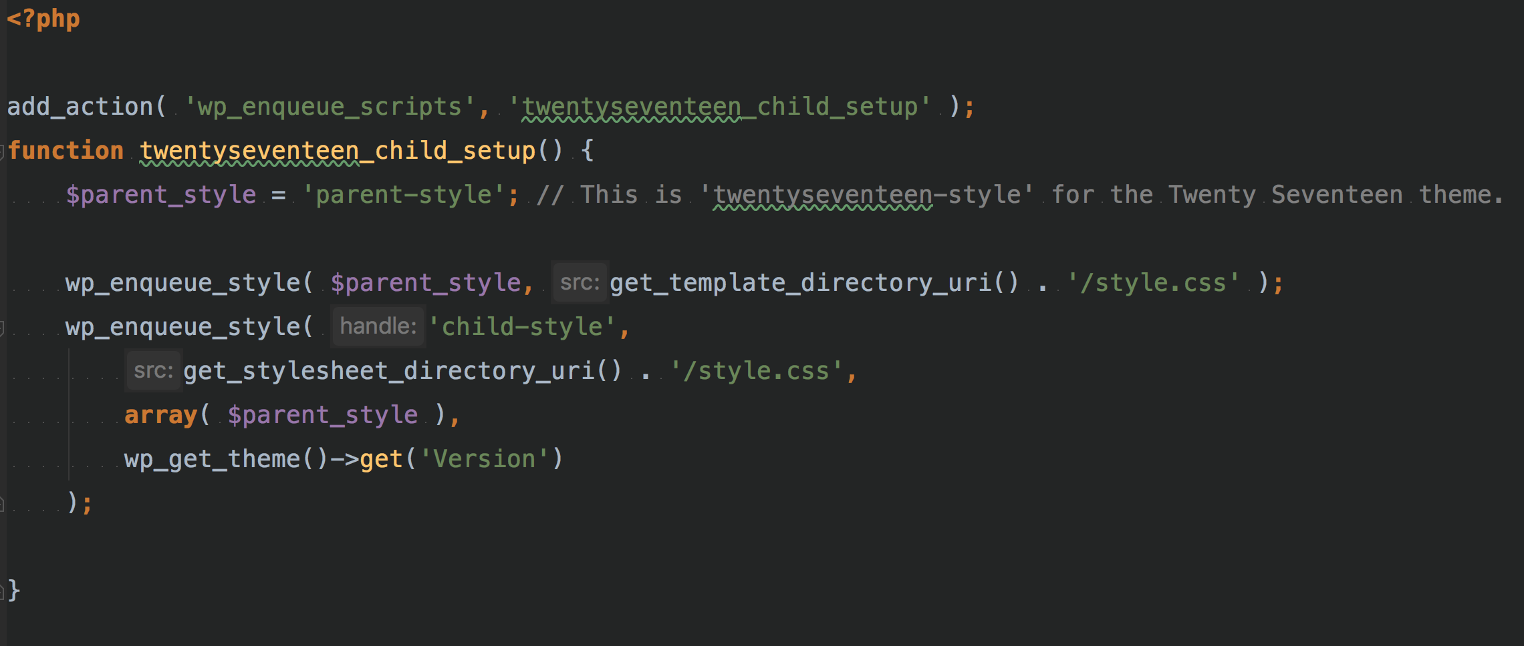
WordPress Theming: Going Beyond the Dashboard
Brian Retterer | @bretterer

Slide 57
WordPress Theming: Going Beyond the Dashboard
Brian Retterer | @bretterer

Slide 58
WordPress
Customizer
WordPress Theming: Going Beyond the Dashboard
Brian Retterer | @bretterer

Slide 59
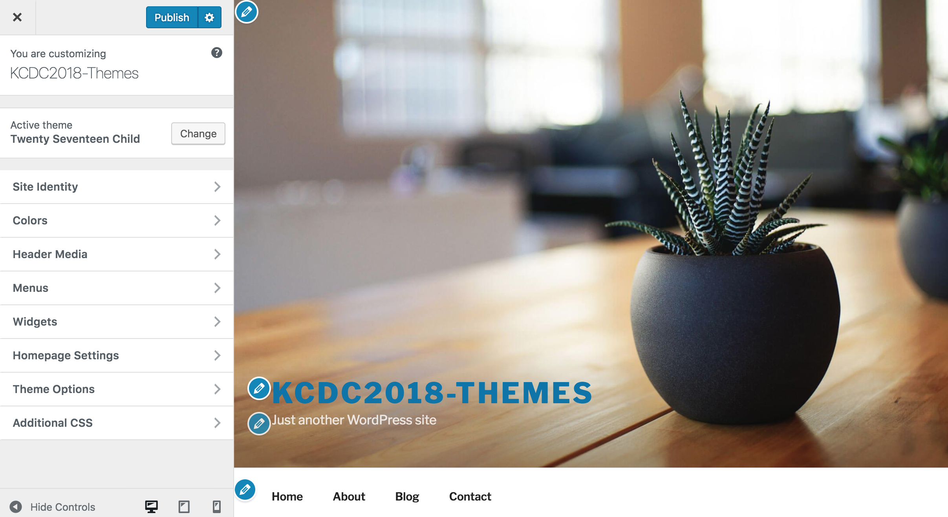
WordPress Theming: Going Beyond the Dashboard
Brian Retterer | @bretterer
Notes:
The Theme Customization API, added in WordPress 3.4, allows developers to customize and add controls to the "Appearance" → "Customize" admin screen. The Theme Customization screen (i.e. "Theme Customizer") allows site admins to tweak a theme's settings, color scheme or widgets, and see a preview of those changes in real time.

Slide 60
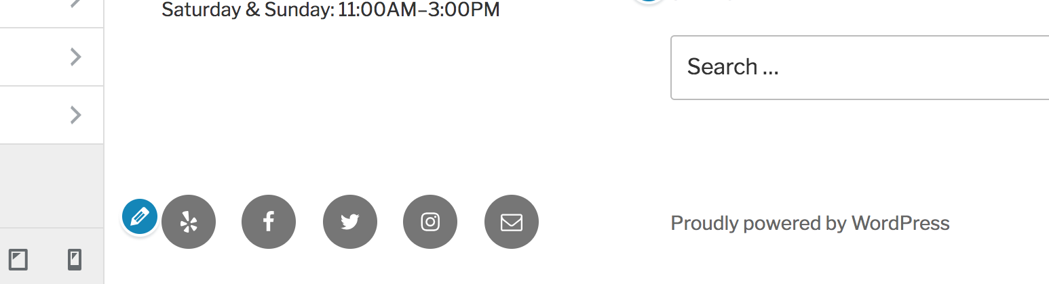
WordPress Theming: Going Beyond the Dashboard
Brian Retterer | @bretterer

Slide 61
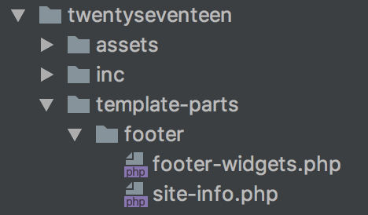
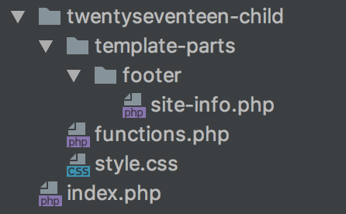
WordPress Theming: Going Beyond the Dashboard
Brian Retterer | @bretterer
Notes:
Copy the File Structure

Slide 62
WordPress Theming: Going Beyond the Dashboard
Brian Retterer | @bretterer

Slide 63
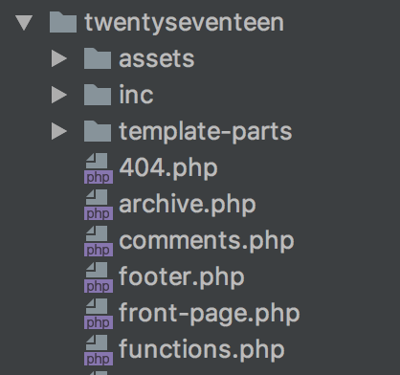
WordPress Theming: Going Beyond the Dashboard
Brian Retterer | @bretterer
Notes:
Create a `functions.php` file

Slide 64
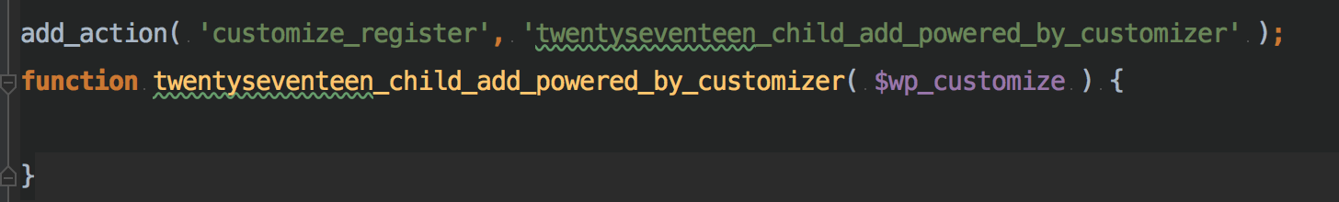
https://codex.wordpress.org/Theme_Customization_API
WordPress Theming: Going Beyond the Dashboard
Brian Retterer | @bretterer

Slide 65
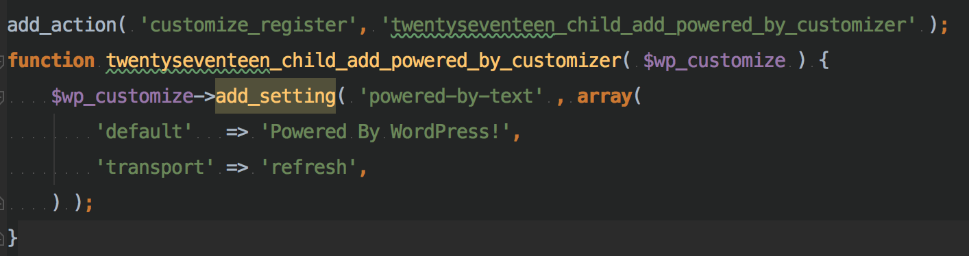
Adding Setting
WordPress Theming: Going Beyond the Dashboard
Brian Retterer | @bretterer

Slide 66
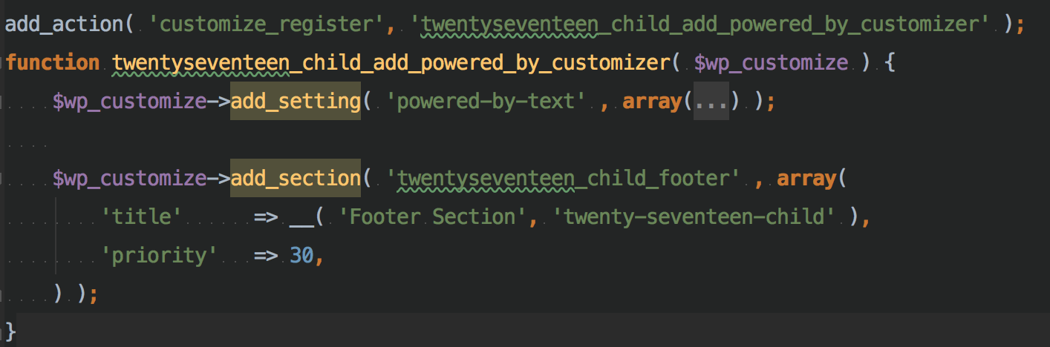
Adding Section
WordPress Theming: Going Beyond the Dashboard
Brian Retterer | @bretterer

Slide 67
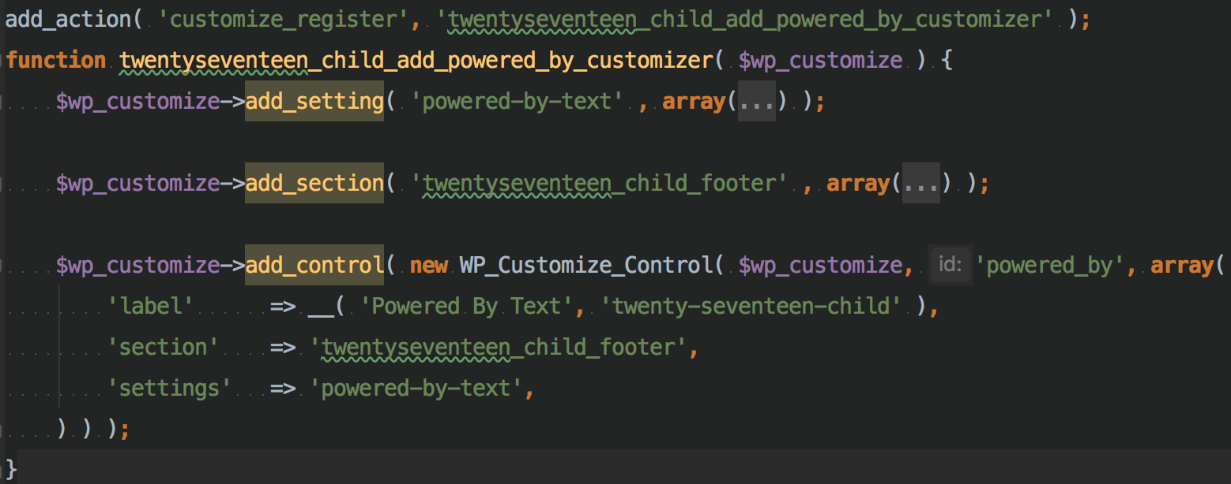
Adding Control
WordPress Theming: Going Beyond the Dashboard
Brian Retterer | @bretterer

Slide 68
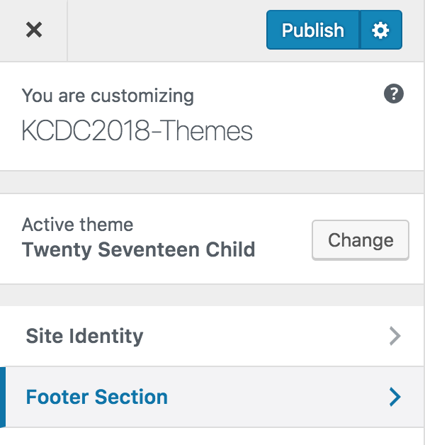
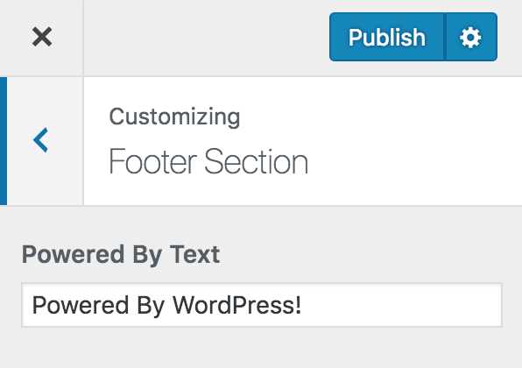
WordPress Theming: Going Beyond the Dashboard
Brian Retterer | @bretterer

Slide 69
WordPress Theming: Going Beyond the Dashboard
Brian Retterer | @bretterer

Slide 70
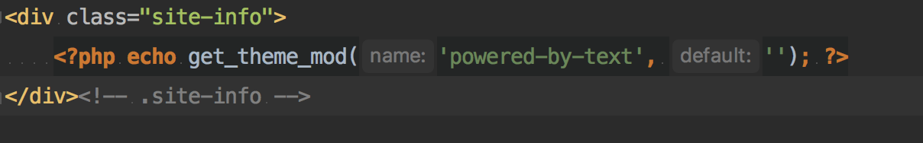
WordPress Theming: Going Beyond the Dashboard
Brian Retterer | @bretterer

Slide 71
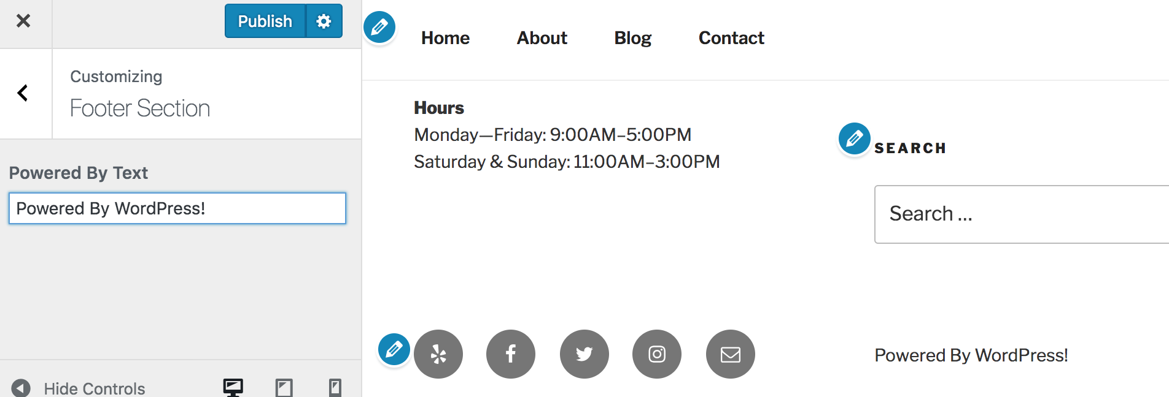
WordPress Theming: Going Beyond the Dashboard
Brian Retterer | @bretterer

Slide 72
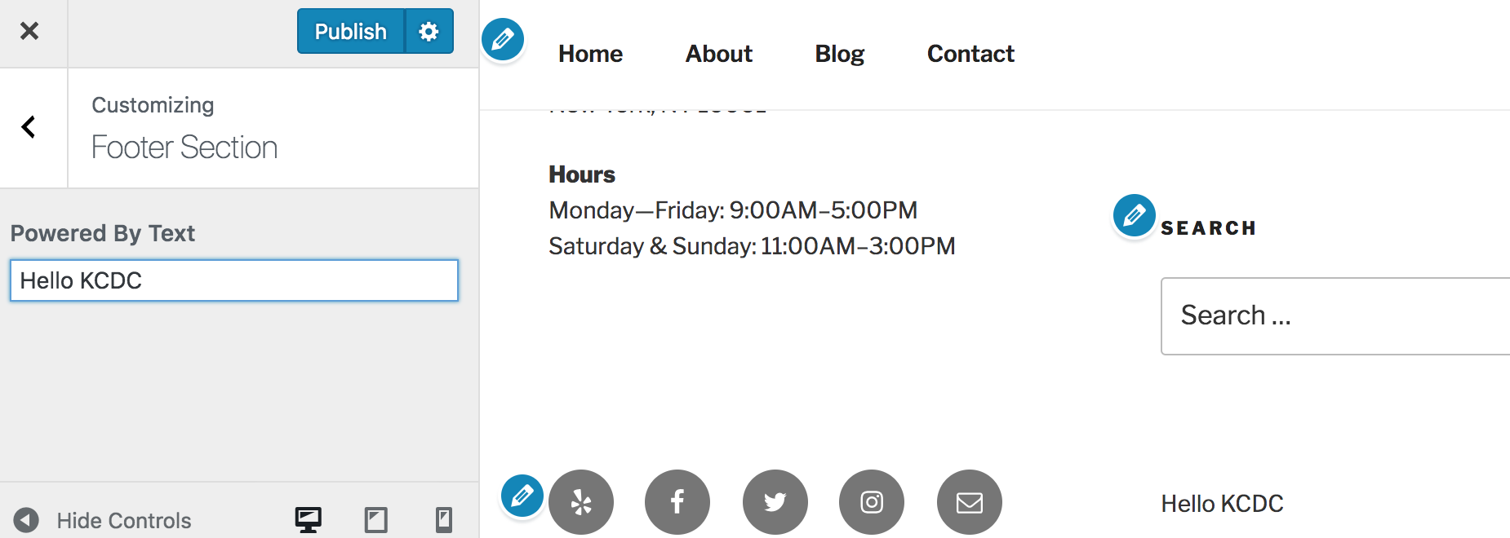
WordPress Theming: Going Beyond the Dashboard
Brian Retterer | @bretterer

Slide 73
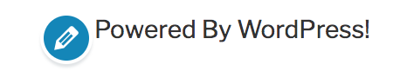
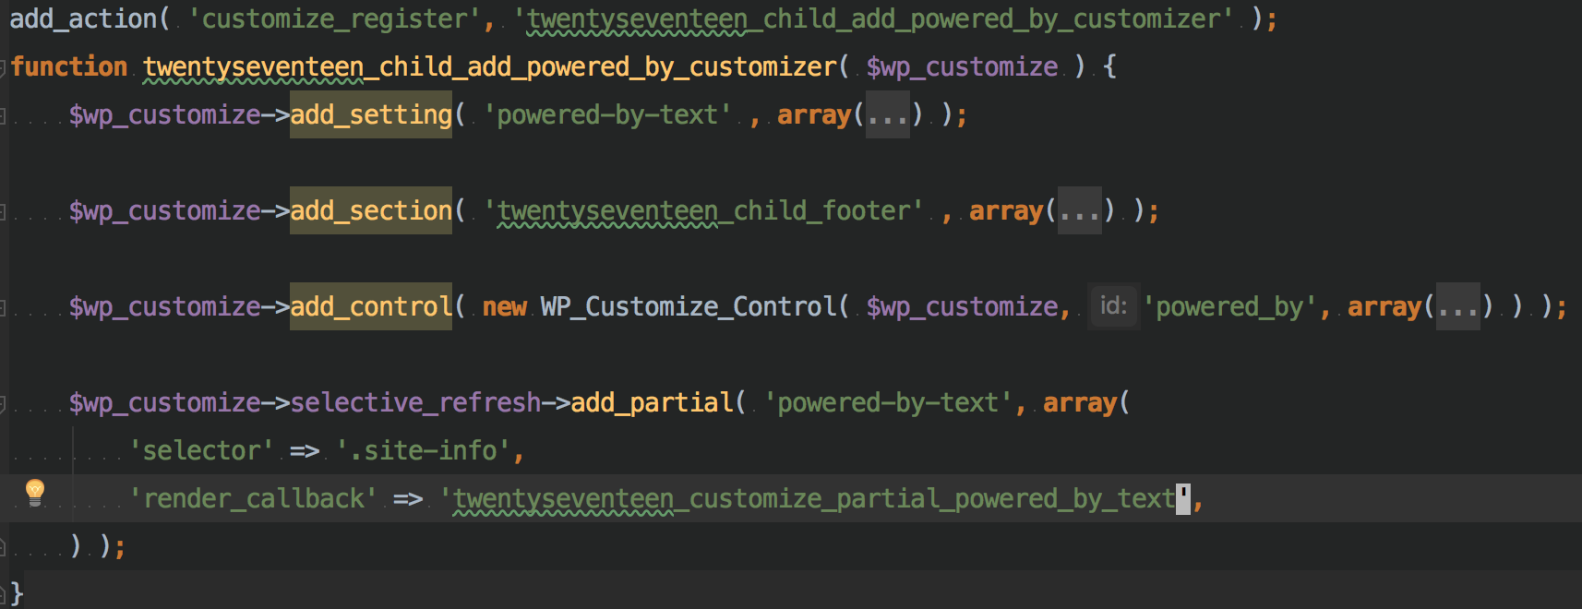
WordPress Theming: Going Beyond the Dashboard
Brian Retterer | @bretterer

Slide 74
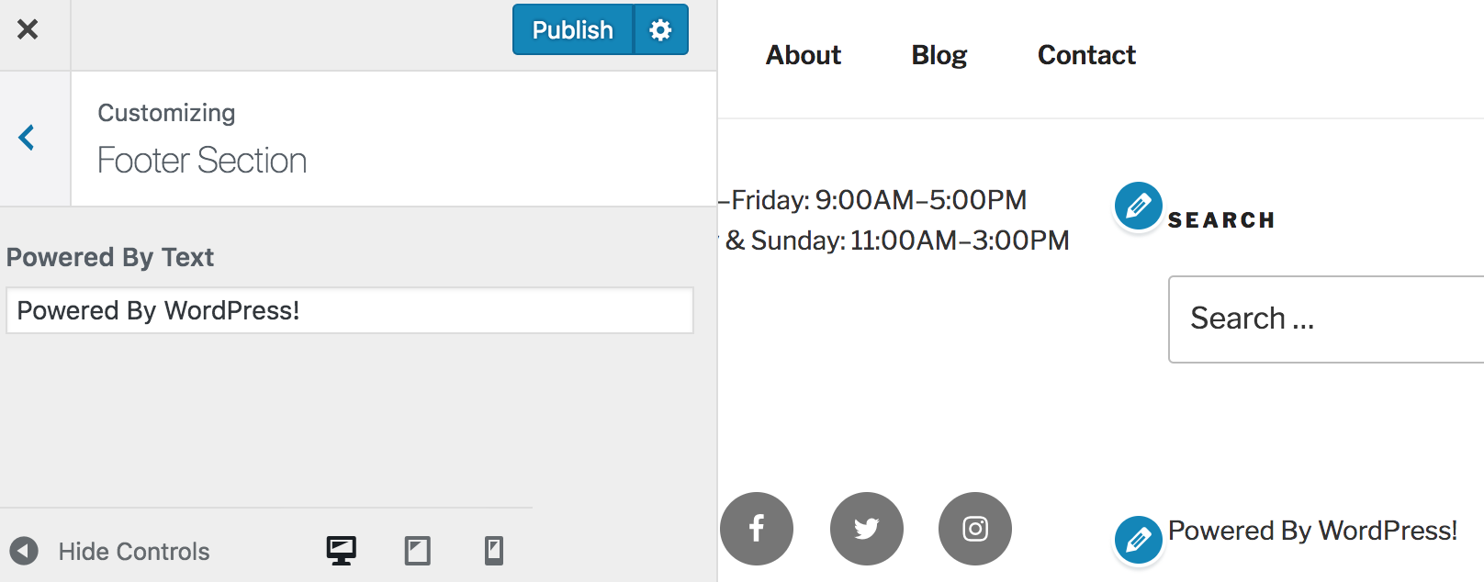
WordPress Theming: Going Beyond the Dashboard
Brian Retterer | @bretterer

Slide 75

Titanium Sponsors
Platinum Sponsors
Gold Sponsors
WordPress Theming: Going Beyond the Dashboard
Brian Retterer | @bretterer

Slide 76
Resources
https://developer.wordpress.org/themes/basics/template-hierarchy/
https://developer.wordpress.org/themes/basics/
https://codex.wordpress.org/Theme_Development
https://codex.wordpress.org/Using_Themes
https://codex.wordpress.org/Child_Themes
http://underscores.me/
https://www.elegantthemes.com/gallery/divi/
https://my.studiopress.com/themes/genesis/
“It's good to be in a role when you can learn something new.”
- Matt Mullenweg
WordPress Theming: Going Beyond the Dashboard
Brian Retterer | @bretterer

